Slide 1

https://www.brainyquote.com/authors

Slide 2
ABB
ambidexterity
cognitive services and other APIs
(hyper)-parameters and other programmable elements
information augmentation
18 automation capabilities
building blocks
intelligence amplification
data strategy
intelligence agents
process capability
elements of business models

Slide 3

https://www.brainyquote.com/authors

Slide 4
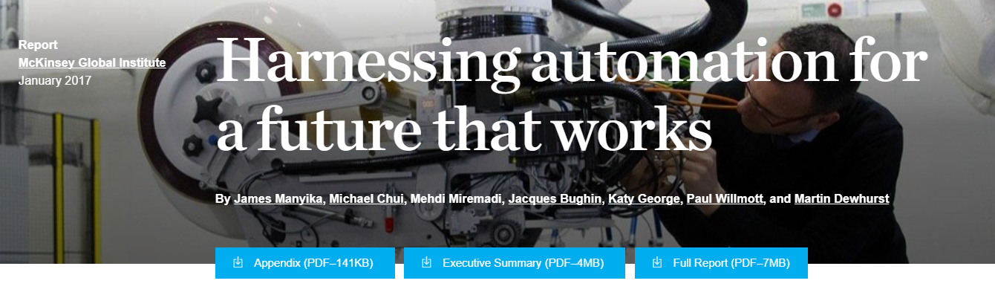
McKinsey Global Institute. (2017). A future that works: automation, employment, and productivity. http://www.mckinsey.com/global-themes/digital-disruption/harnessing-automation-for-a-future-that-works
https://public.tableau.com/profile/mckinsey.analytics#!/vizhome/AutomationBySector/WhereMachinesCanReplaceHumans and
https://public.tableau.com/profile/mckinsey.analytics#!/vizhome/InternationalAutomation/WhereMachinesCanReplaceHumans and
https://public.tableau.com/profile/mckinsey.analytics#!/vizhome/AutomationandUSjobs/Technicalpotentialforautomation

Slide 5
18 automation capabilities of the work activities within the criteria for the automation (i.e., accept input, information processing, deliver output, and physical movement) are as follows (McKinsey 2017, 34−35, 120−123):
Accept input − Natural language understanding. Ability to “comprehend language, including nuanced human interaction”
Accept input – Sensory perception. Ability to “autonomously infer and integrate complex external perception using sensors” (i.e., “visual perception, tactile sensing, and auditory sensing, and involves complex external perception through integrating and analyzing data from various sensors in the physical world”)
Accept input – Social and emotional sensing. Ability to “identify social and emotional state”
Information processing – Recognizing known patterns / categories (supervised learning). Ability to “recognize simple / complex known patterns and categories other than sensory perception”
Information processing – Generation of novel pattern / categories. Ability to “create and recognize new patterns/categories (e.g., hypothesized categories)”
Information processing – Logical reasoning / problem solving. Ability to “solve problems in an organized way using contextual information and increasingly complex input variables other than optimization and planning”
Information processing – Optimization and planning. Ability to “optimize and plan for objective outcomes across various constraints”
Information processing – Creativity. Ability to “create the diverse and novel ideas, or the novel combinations of ideas”
Information processing – Information retrieval. Ability to “search and retrieve information from a large scale of sources (breadth, depth, and degree of integration)”
Information processing – Coordination with multiple agents. “Interact with others, including humans in, to coordinate group activity”
Information processing – Social and emotional reasoning. Ability to “accurately draw conclusions about social and emotional state, and determine appropriate response/action”
Deliver output – Output articulation / display. Ability to “deliver outputs /visualizations across a variety of mediums other than natural language” (i.e., “automated production of pictures, diagrams, graphs, or mixed media presentations”)
Deliver output – Natural language generation. Ability to “deliver messages in natural language, including nuanced human interaction and some quasi language (e.g., gestures)”
Deliver output – Emotional and social output. Ability to “produce emotionally appropriate output (e.g., speech, body language)”
Physical movement – Fine motor skills / dexterity. Ability to “manipulate objects with dexterity and sensitivity”
Physical movement – Gross motor skills. Ability to “move objects with multidimensional motor skills”
Physical movement – Navigation. Ability to “autonomously navigate in various environments”
Physical movement – Mobility. Ability to “move within and across various environments and terrain”

Slide 6
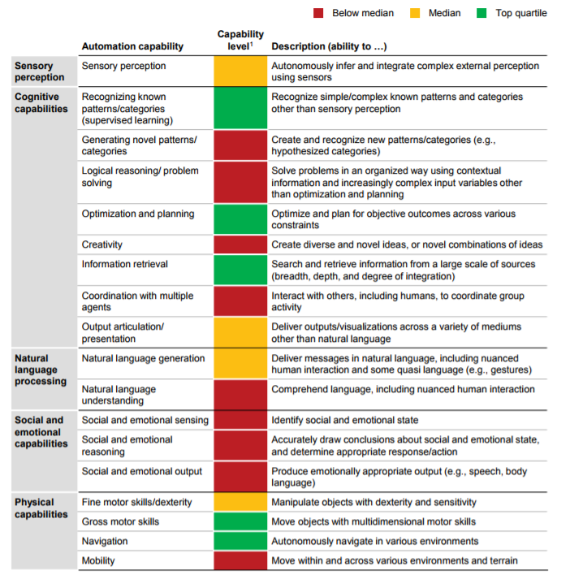
Current technologies have achieved different levels of human performance across 18 capabilities
McKinsey Global Institute. (2017). A future that works: automation, employment, and productivity.

Slide 7
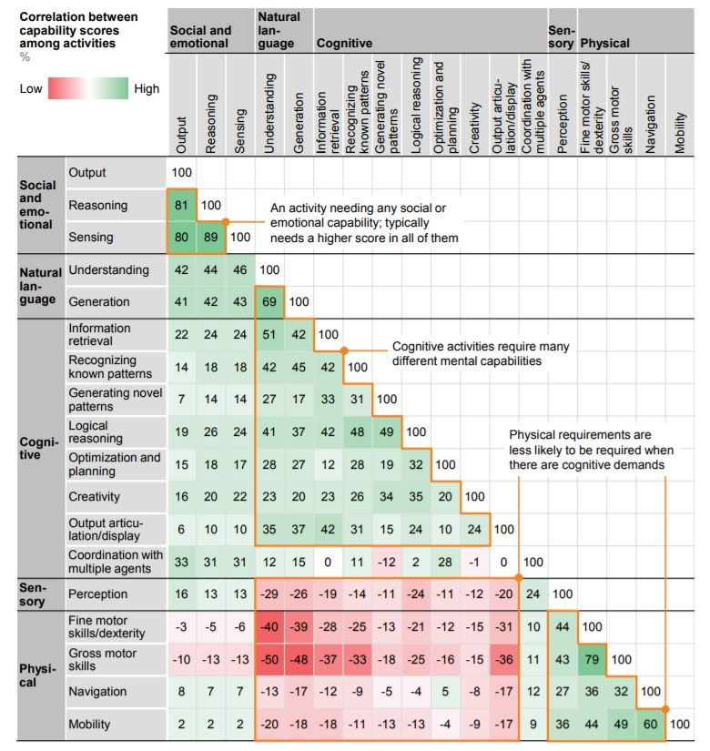

Slide 8
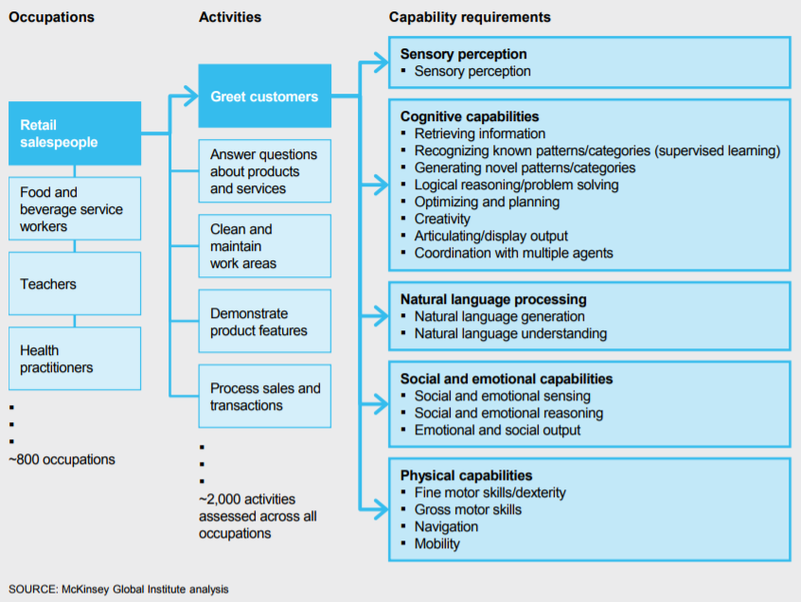
McKinsey Global Institute. (2017). A future that works: automation, employment, and productivity.

Slide 9
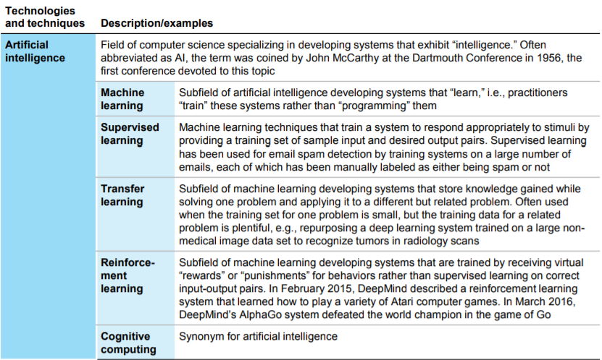
McKinsey Global Institute. (2017). A future that works: automation, employment, and productivity.

Slide 10
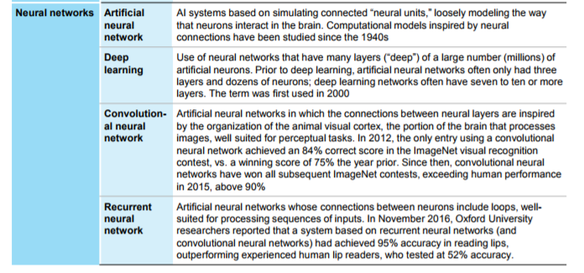
McKinsey Global Institute. (2017). A future that works: automation, employment, and productivity.

Slide 11
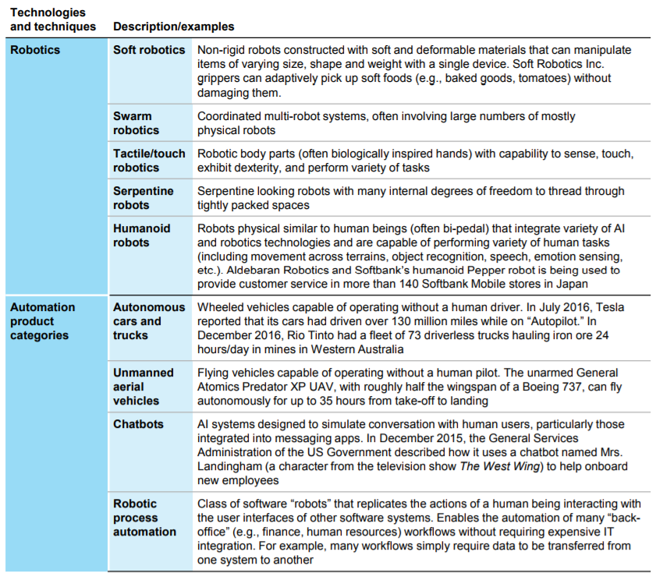
McKinsey Global Institute. (2017). A future that works: automation, employment, and productivity.

Slide 12
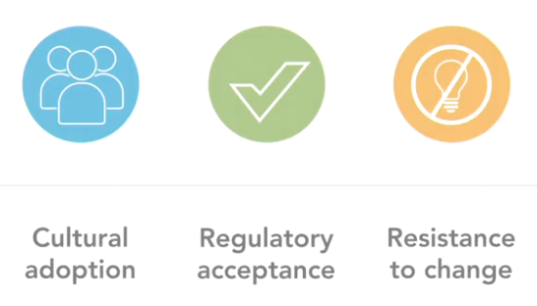

New technology needs knowledge and understanding, i.e., a critical mass of appreciation is reached => rapid innovations and adaptions are needed. Furthermore, new technology needs time to mature => uniform engineering or technical criteria, methods, processes, practices (i.e., standards) and other authority documents (i.e., regulations and laws), policies, treaties and agreements. For example, the following challenges concern block chain.
https://www.linkedin.com/learning/blockchain-basics/the-potential-obstacles-to-blockchain-adoption

Slide 13
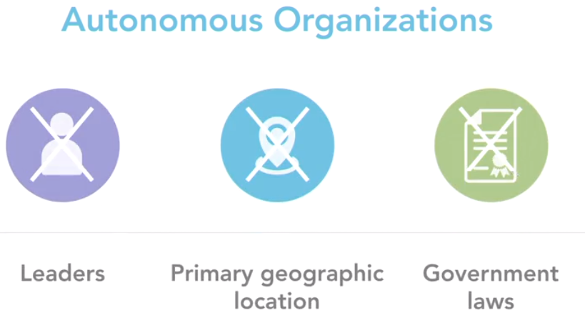

Blockchain It's a peer-to-peer network architecture meaning that all participants are equal in their role on the network and its topology is flat, in other words, unlike for example a client's server, it is without hierarchy.
https://www.delltechnologies.com/en-us/perspectives/democracy-2-0-how-blockchain-technology-is-unveiling-a-new-type-of-democracy/

Slide 14
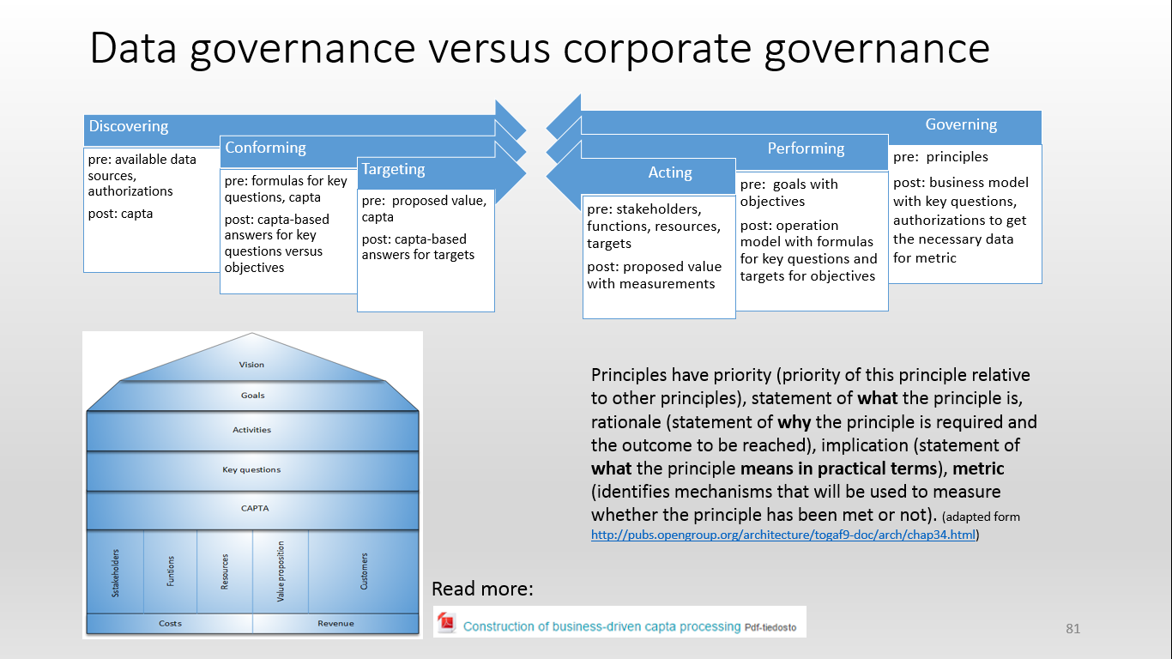

Slide 15
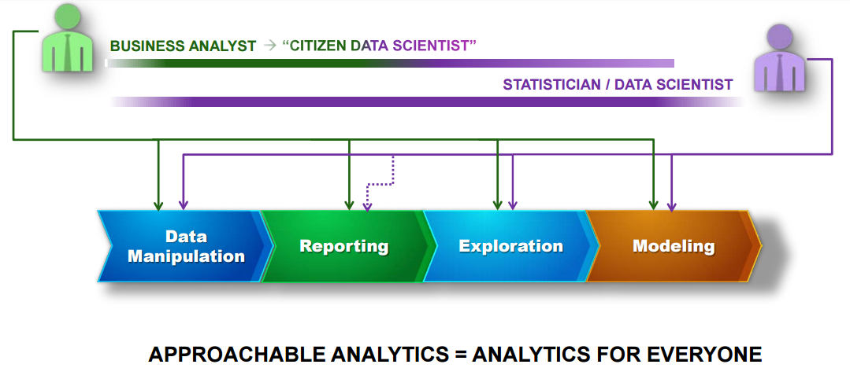
Analytics for everyone
Picture source: https://www.sas.com/content/dam/SAS/fi_fi/doc/Events/SAS%20Forum%202015/Presentation_SAS_INSTITUTE_OY-SAS_Forum_FI_2015_Tobias_Witt_SAS_keynote_(ID_40414).pdf

Slide 16
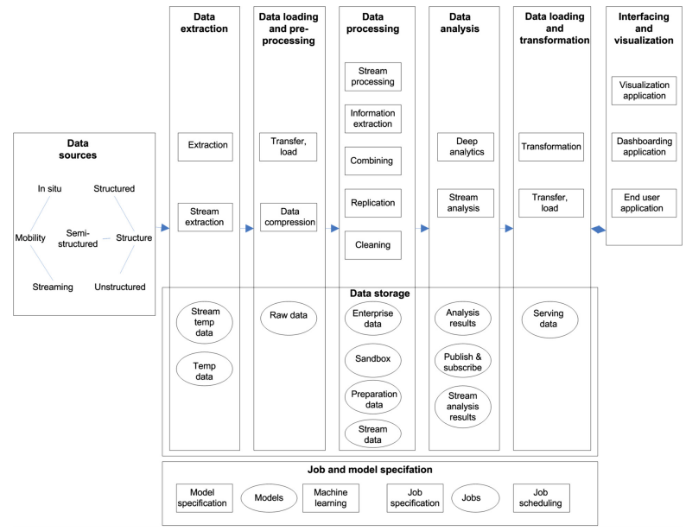
Pekka Pääkkönen, Daniel Pakkala, Reference Architecture and Classification of Technologies, Products and Services for Big Data Systems, Big Data Research, Available online 2 February 2015,
http://www.sciencedirect.com/science/article/pii/S2214579615000027

Slide 17
Two types of files: binary (used by various programs; compressed/encrypted format) and text (can be processed easily by any program or editor)
.csv (comma-separated text file that you can open with Excel or Notepad; it can have more than 1 million rows),
.xlsx (Excel files limited to 1 million rows, this is a binary file),
.gz (compressed files, thus binary files),
.png (best image format, other image formats include .gif, .jpg, .jpeg, and .bmp; these are binary files),
.docx (Word documents; binary),
.html (text files representing source code of a web page),
.sql (text file used to store an SQL query, used as input for some database clients such as Brio),
.php (PHP code, text format),
.pl (Perl code, text format),
.js (Javascript code, text format),
.r (R code, text format),
.py (Python code, text format),
.c (C code, text format),
.exe (Windows executable),
.xml (XML, text format for name-value pairs)
Source: http://www.datasciencecentral.com/profiles/blog/show?id=6448529:BlogPost:189956&&utm_content=buffera83fd&utm_medium=social&utm_source=linkedin.com&utm_campaign=buffer

Slide 18
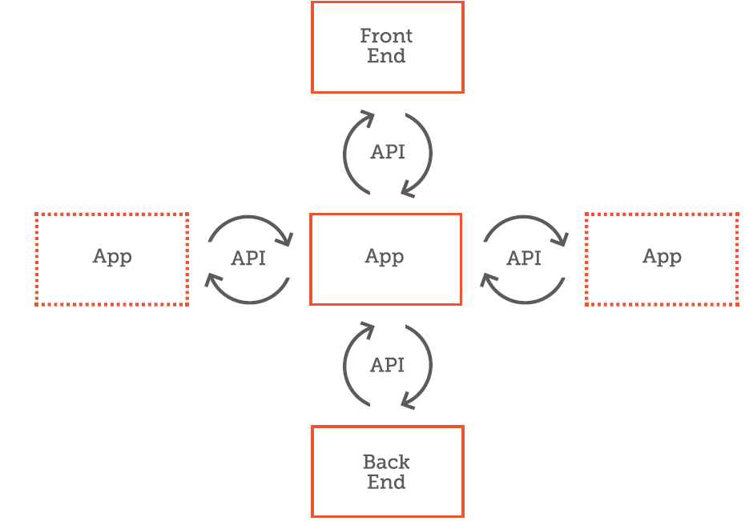
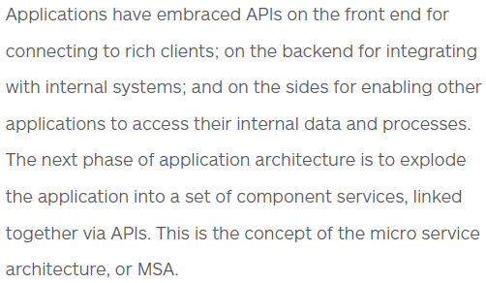
API-based application architecture
Source: APIGEE: APIs are Di!erent than Integration Internet & Enterprise Technologies Unite in a New Enterprise Foundation,. eBook, https://pages.apigee.com/rs/apigee/images/APIs-not-integration-ebook-05-2014.pdf

Slide 19
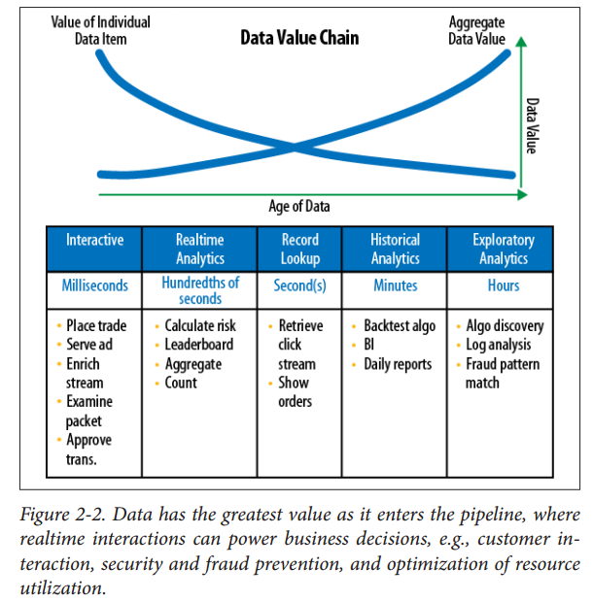
“Latency is a time interval between the stimulation and response, or, from a more general point of view, as a time delay between the cause and the effect of some (physical) change in the system being observed”
https://en.wikipedia.org/wiki/Latency_(engineering)
Source: http://voltdb.com/sites/default/files/VoltDB%20eBook.pdf

Slide 20

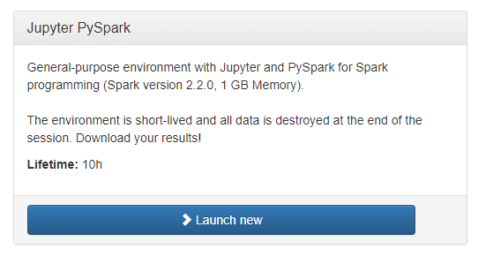
https://notebooks.csc.fi/#/dashboard

Slide 21
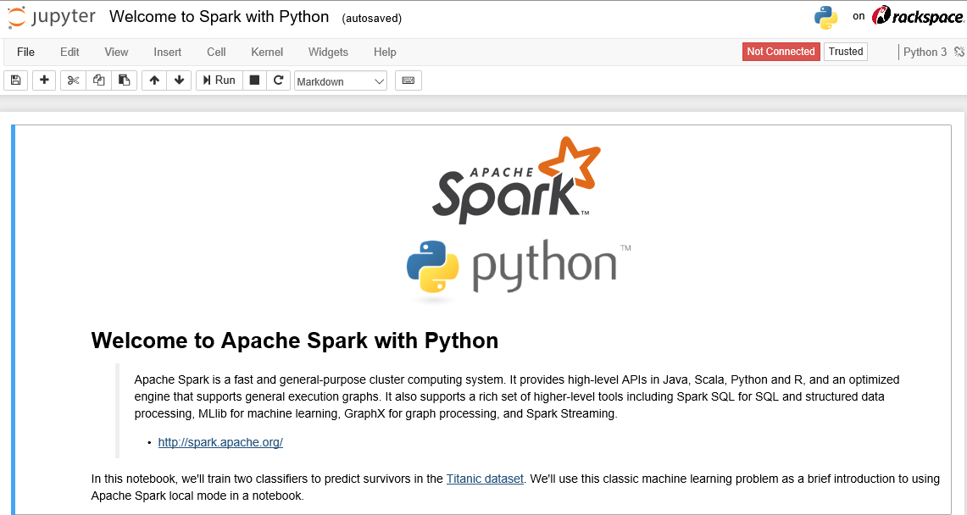

Slide 22
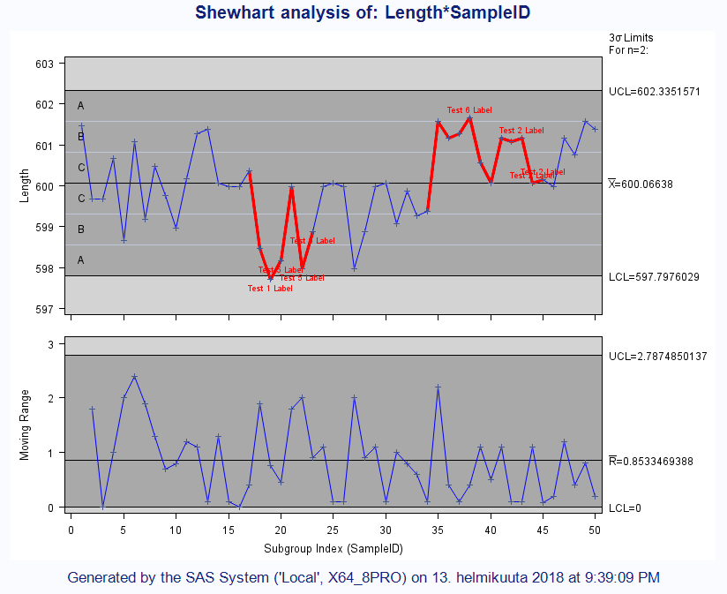
Exercise 7 with SAS

Slide 23
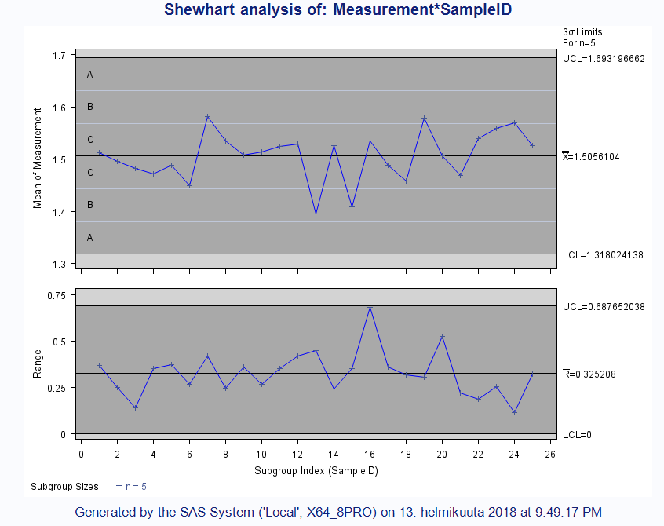
Exercise 8 with SAS

Slide 24
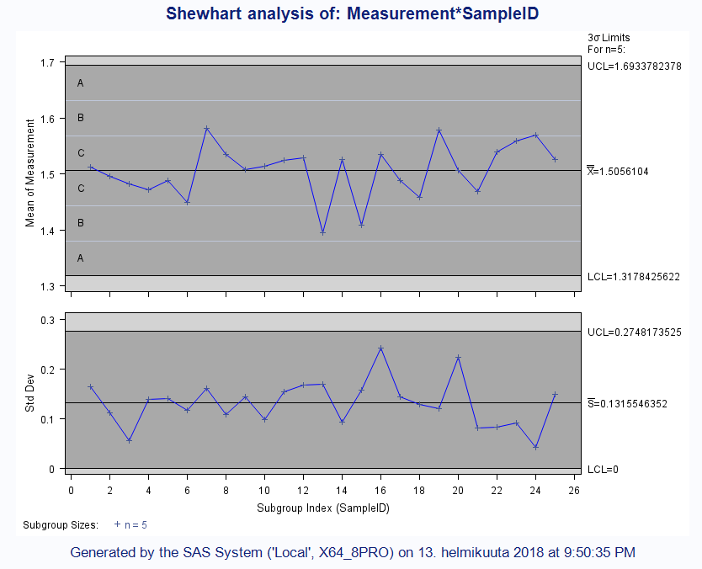
Exercise 8 with SAS

Slide 25
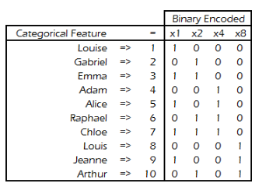
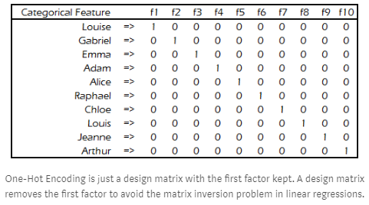
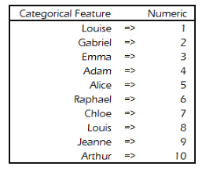
There are many ways to deal with categorical data
https://medium.com/data-design/visiting-categorical-features-and-encoding-in-decision-trees-53400fa65931
http://contrib.scikit-learn.org/categorical-encoding/
https://github.com/scikit-learn-contrib/categorical-encoding

Slide 26
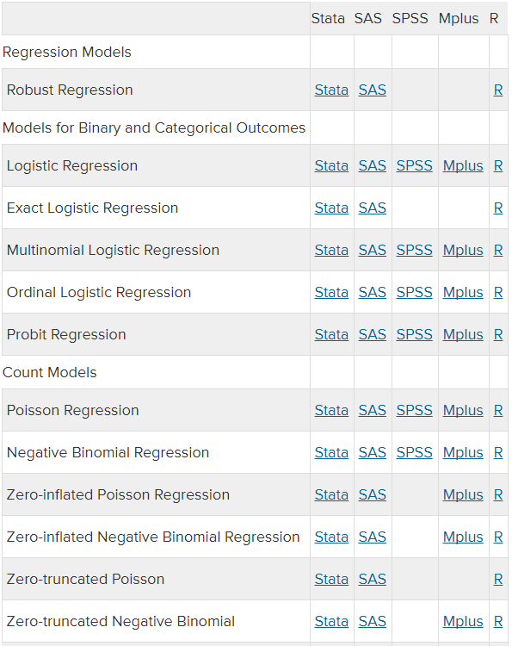
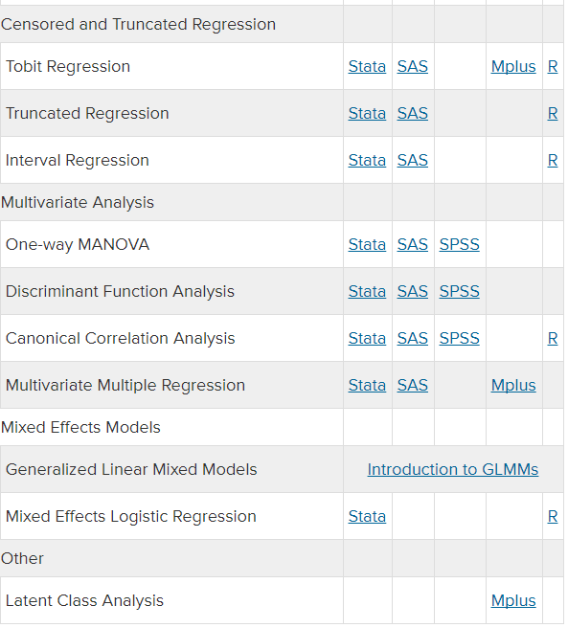
https://stats.idre.ucla.edu/other/dae/

